Slide 1

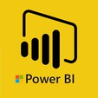
Hii,
Iam Siddhika
Welcome to Power BI Series
Part -81

Slide 2



I’m very excited to dive into this with you all!
Are you ready to enhance your data visualization skills?
We focus only few visuals...
Today Content
VISUALIZING DATA
PARAMETERS
INTRODUCTION
TYPES OF PARAMETERS

Slide 3

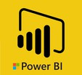
WHAT ARE PARAMETERS IN POWER BI?
check next slide..
Parameters are variables that can be used in measures and controlled by users through slicers.
They make reports more interactive and dynamic, allowing users to adjust inputs and see the impact on data.

Slide 4

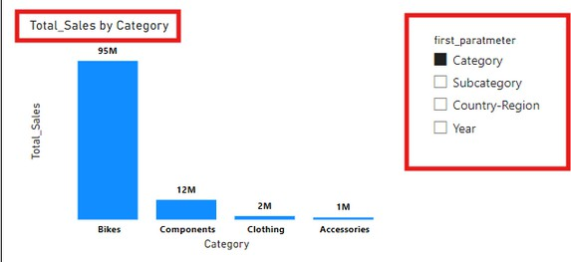
TYPES OF PARAMETERS
Don't worry
we will see
each with
There are 2 types of parameters
1. Fields Parameters:
Typically used for scenario testing, where users can adjust numerical values to see how different scenarios affect the outcome.
Example: If you have multiple metrics (like Revenue, Profit, or Sales), a fields parameter lets users select which metric they want to display on the chart, updating the visual dynamically.
example in
next part

Slide 5

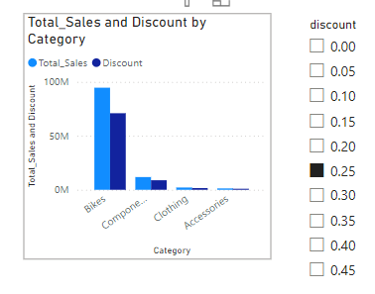
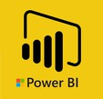
NUMERIC RANGE PARAMETERS
Typically used for scenario testing, where users can adjust numerical values to see how different scenarios affect the outcome.
Example: If you're analyzing profit, you can create a parameter to adjust the "Price Adjustment %" and see how changes in pricing impact the overall profit.
Don't worry
we will see
each with
example in
next part

Slide 6


Thank you for joining me today to learn about Part -81 of Power BI!
Remember, Effective data visualization is crucial for turning data into meaningful insights and compelling narratives with Power BI.
Stay tuned for more insights and tips on Power BI in our next Series.
Follow

